Slide 1
ICT1101: Basic Computing
Lecture 01
Introduction
Ms. Abido Scovia
(MSc, BSc)
Department of Computing & Technology
Faculty of Engineering, Design & Technology
January 2024

Slide 2
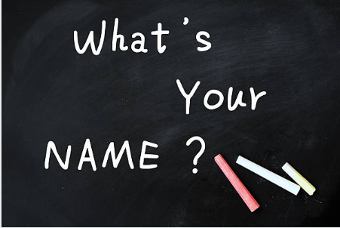

INTRODUCTIONS

Slide 3
COURSE DESCRIPTION
The students will be introduced to the basic concepts of Information Technology, the use of the Internet and office applications like a word processor, presentation and spreadsheets, and the amazing things computers are doing in their field of study.

Slide 4
COURSE OBJECTIVE
To equip students with computing knowledge and skills for personal use, the work place and society at large.

Slide 5
GENERAL LEARNING OUTCOMES
By the end of this course, students should be able to;
Understand key concepts of computing and its integration in contemporary times.
Identify and use computing resources that are unique to their area of specialization

Slide 6
GENERAL LEARNING OUTCOMES
By the end of this course, students should be able to;
Demonstrate ability to use various applications to create documents, presentations and spreadsheets
Display personal responsibility in using technology

Slide 7
Course Overview
Topic 1: Basic Concepts of I.T
Topic 2: Computer Networks, Internet
Topic 3: Word Processing
Topic 4: Spreadsheets
Topic 5: Semester Project, Presentation software

Slide 8
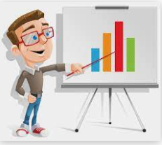


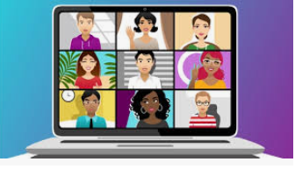
TEACHING METHODS (Blended Approach)

Slide 9
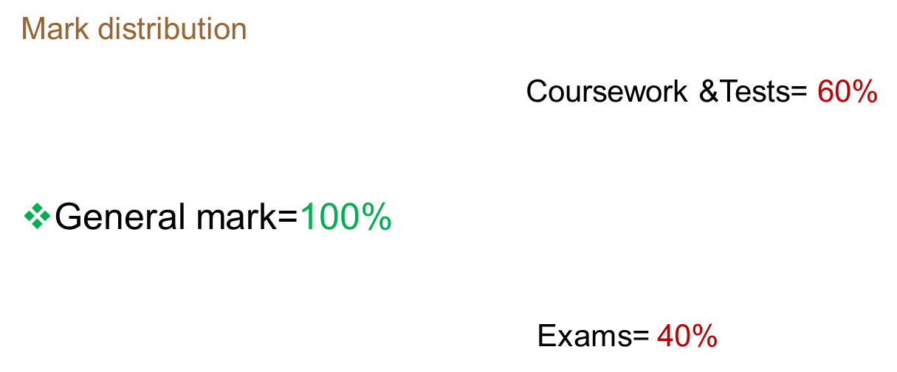
COURSE EVALUATION

Slide 10

COURSE ASSESSMENT CRITERIA
Course Work(Out of 60)
Semester Project 20%
Theory Test 15%
Practical Test 15%
Individual Assignments 10%
Final semester Examination (Out of 40)

Slide 11
ASSESSMENT CRITERIA
Student should score a minimum of 21 out of 60 in course work to qualify for the exam.
Student should score a minimum of 14 in the final exam.
The total of both coursework and exam should be greater than or equal to (≥) 50 for the student to pass this course.

Slide 12
Guidelines
Everyone is required to pray in case chosen in any of the lectures.
Everyone should participate(Interactive).
Do all the work assigned to you and submit in time.
Communicate as early as possible in case you are sick or not able to attend any of my lectures/tests with a genuine reason.

Slide 13
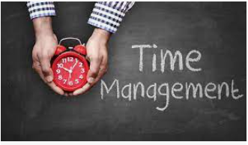

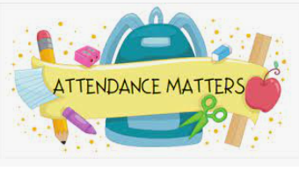

Guidelines
Extra research is highly encouraged.

Slide 14

Any questions??

Slide 15
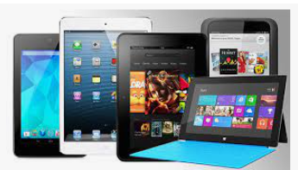
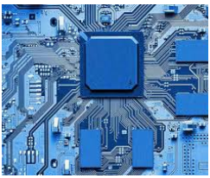
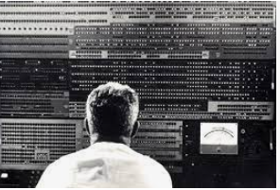
BASIC CONCEPTS OF I.T
What is a computer?

Slide 16
BASIC CONCEPTS OF I.T
Attributes of a computer
Electronic
Programmable
General purpose

Slide 17
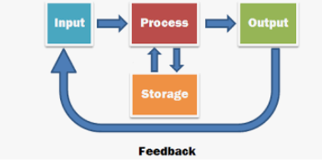
BASIC CONCEPTS OF I.T
Functions/capabilities of a computer

Slide 18
BASIC CONCEPTS OF I.T
DATA
INFORMATION
Data is raw , unorganized facts that need to be processed.
Example: each students score in a test
Data that is processed, organised, structured or presented in a give context to make it useful.
Example: average score of a class or entire school

Slide 19
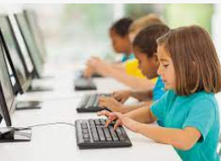
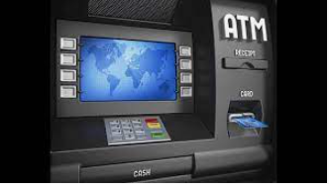
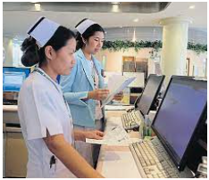
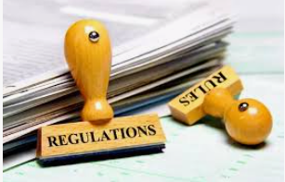
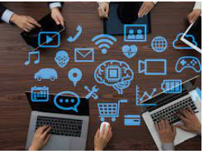
BASIC CONCEPTS OF I.T
Computers in everyday life

Slide 20
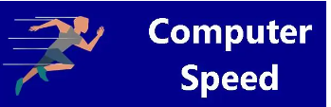



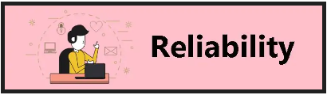
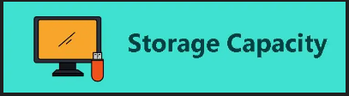
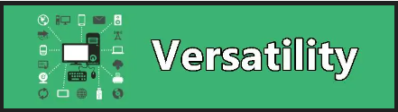
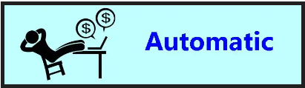
BASIC CONCEPTS OF I.T
Advantages of computers

Slide 21
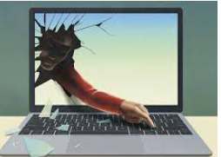
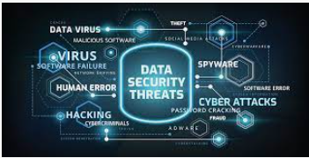

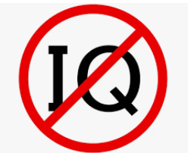
BASIC CONCEPTS OF I.T
Dis-advantages of computers

Slide 22
Disadvantages of Computers
No I.Q
Dependency
Privacy violation
Unemployment
health risks from prolonged use or mis-use
crimes like hacking etc..

Slide 23
Types of Computers
Micro computers (PCs):
fit on the desk and can be carried around
used by a single user
Examples desktop, laptops, note books, towers, handheld devices etc..

Slide 24
Types of Computers
Mini computers:
medium power more than micro computer but less than main frame computers.
Mainly used as small or mid range servers for business applications

Slide 25
Types of Computers
Mainframe computers:
Large and powerful used by large organisations like banks and airlines.
Store huge amounts of data
hundreds or thousands of connected users simultaneously

Slide 26
Types of Computers
Super computers:
fastest, most powerful machines.
Process tremendous amounts of data
Used for applications that require complex and sophisticated mathematical applications.
Used in the military and weather forecasting stations.

Slide 27
Reading assignment for discussion in the next class
Components of a computer
Computer generations

